Slide 1
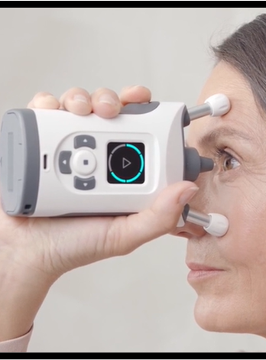
Bringing Sight to Life: Value Based Medicine with home tonometry for glaucoma
Adam Lang
University of Denver University College
November 5, 2023
Faculty: Matt Vestal, M.H.A.
Director: Jeffrey Weide, DBA
Dean: Michael J. McGuire, MLS

Slide 2
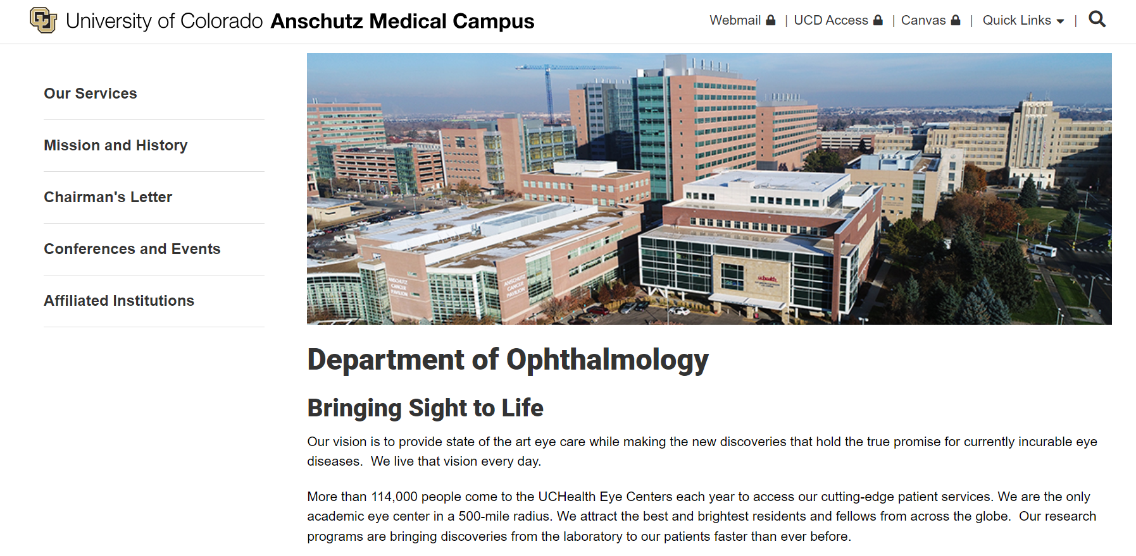
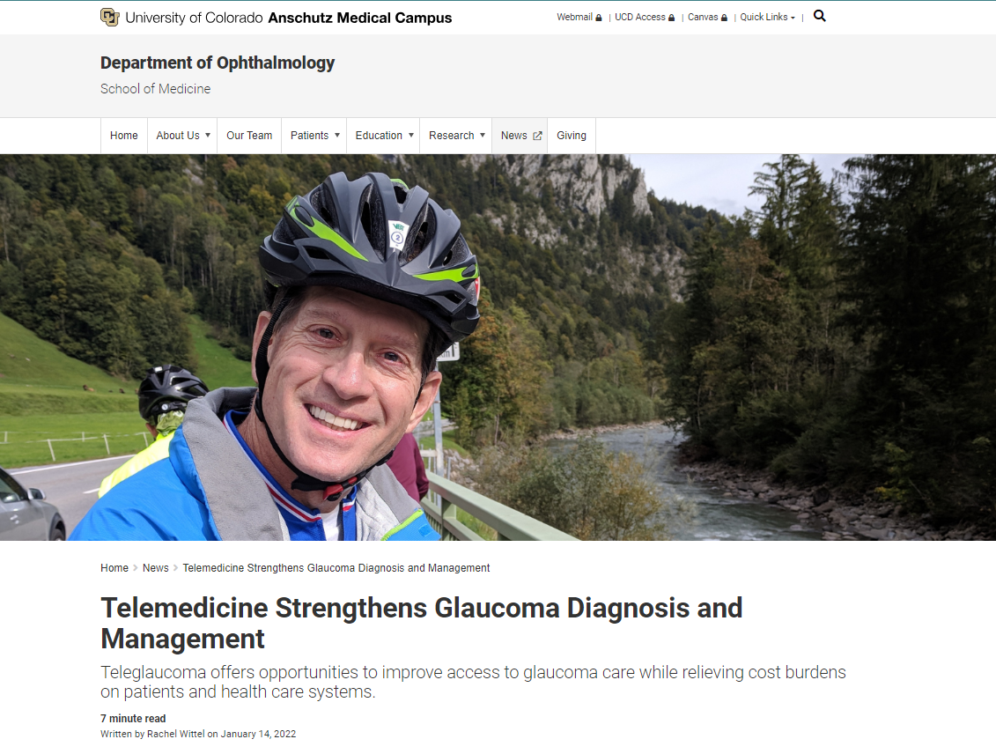
Scenario “Pitch”
Department of Ophthalmology at University of Colorado Anschutz Medical Campus
Teleglaucoma
500-mile radius
Utilized iCare HOME (version 1)
Source: CU Anschutz, 2023. "Department of Ophthalmology." Accessed on October 28, 2023. https://medschool.cuanschutz.edu/ophthalmology/about-us
Source: Wittel Rachel, 2022. "Telemedicine Strengthens Glaucoma Diagnosis and Management." Accessed on October 28, 2023. https://news.cuanschutz.edu/ophthalmology/telemedicine-strengthens-glaucoma-diagnosis-and-management
Notes:
Scenario for this Pitch:
- Presentation to Dept of Ophthalmology at CU Anschutz Medical Campus in Denver and purchasing committee at hospital.
- Why? The Ophthalmology clinic utilized the original iCare HOME tonometer version 1 for Teleglaucoma as you see in the article above.
- CU Anschutz is the only Academic Eye Center in a 500 mile radius treating patients from all over the Rocky Mountain region including: Wyoming, Montana, Eastern Utah, all of Kansas, and a lot of Nebraska.
- Social Determinants frequently hinder patients traveling long distances to see them, thus teleglaucoma with home tonometry plays a vital role in care delivery.
- For this pitch we want to discuss why the iCare HOME2 digital health app is a viable option for the medical center to invest in.

Slide 3
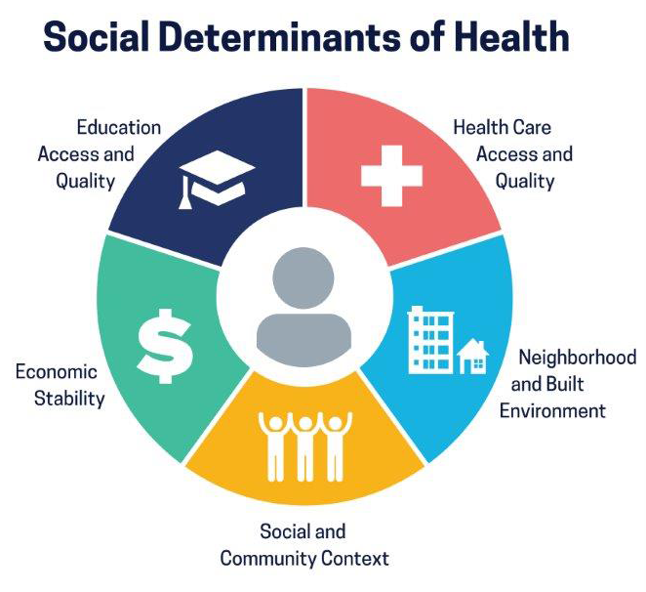
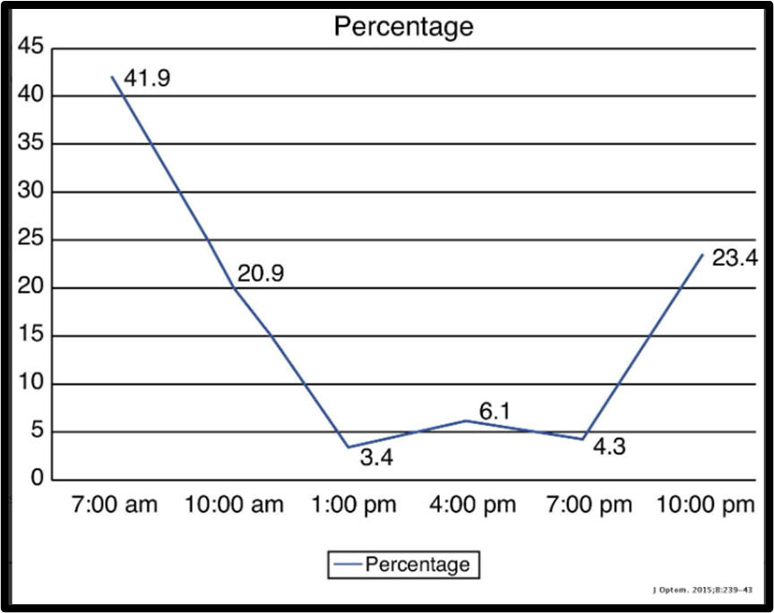
Glaucoma Problems
#1 cause of irreversible blindness worldwide
Medical Cost: $6.1 billion => $12 billion (2032)
Social Determinants of Health
“Silent blindness” – 50% undiagnosed
Diurnal intraocular pressure (IOP) changes occur outside of “clinic time”
Source: CDC, 2023. "Social Determinants of Health, Health Equity, and Vision Loss." Accessed on October 28, 2023. https://www.cdc.gov/visionhealth/determinants/index.html
Source: Tarun Arora, Shveta Jindal Balib, Vishal Aroraa, Meenakshi Wadhwania, Anita Pandaa, Tanuj Dadaa, 2015. "Diurnal versus office-hour intraocular pressure fluctuation in primary adult onset glaucoma.“ Journal of Optometry 8, no. 4 (October-December 2015): 239-243, https://doi.org/10.1016/j.optom.2014.05.005
Notes:
Things you likely know already: Glaucoma is #1 cause of irreversible blindness and the Cost of treatment is astronomical.
- We know firsthand the social determinants of health such as transportation and access to care not only contribute to glaucoma disease progression but hinder patient’s receiving consistent care. The SDOH wheel seen above form the backbone of the CDC’s vision health initiative to help prevent diseases like glaucoma that cause blindness.
- The biggest problem with glaucoma is patients are silently becoming blind without their knowledge. 50% of patients are undiagnosed due to infrequent clinic visits where an intraocular pressure (IOP) is obtained every 3 to 4 months or even once a year.
- The graph we see above is from a well known study that showed the “diurnal” fluctuations of IOPs. Frequently the IOP measures will be normal during clinic hours but spike overnight or in the early morning hours thus providers will never see a consistent diagnostic IOP during a patient visit.

Slide 4
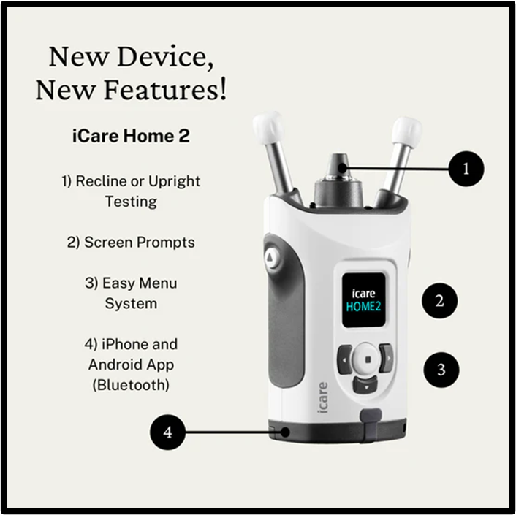
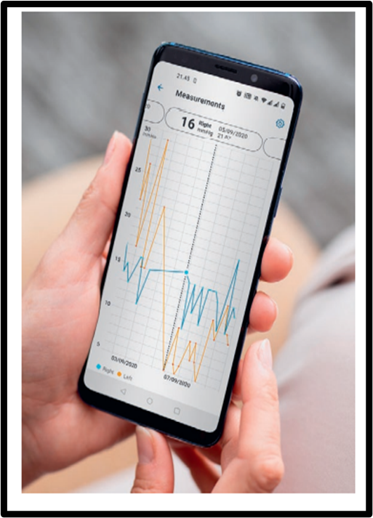
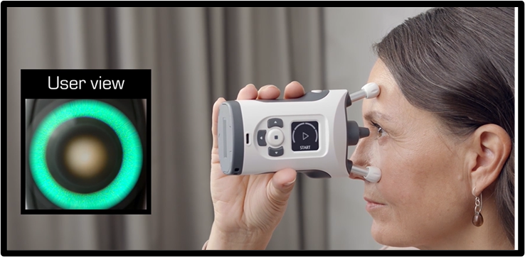
Digital Health Solution
iCare HOME2 Tonometer
Non-contact IOP measurements
Real-time IOP data
Digital Applications for data
User friendly
FDA 510(k) clearance
January 2022 (FDANEWS, 2022)
Class II medical device
Source: iCare, 2023. "iCare HOME2." Accessed on September 19, 2023. https://www.icare-world.com/us/product/icare-home2/
Notes:
- Previously the CU Dept of Ophthalmology had been using the iCare HOME which was the earliest version of a non-contact home tonometer.
- Today I present to you the newest version the iCare HOME2. The improvements include:
Patient is able to take measures in any position (supine, standing, sitting).
Real-time data collection for immediate review by the provider and patient.
Digital applications on mobile device, computer and cloud for data transmission, storage, and analytics.
User friendly. The device now notifies the patient of the correct eye position with cues via a green light.
- The iCare HOME2 received FDA 510(k) clearance in January 2022.
It is registered as a Class II medical device.
This means it was approved via “pre market notification” which validates the device has similar functionality, safety and efficacy as other devices already approved on the market.
The previous version of this device the “iCare HOME” was likely one of the devices it was compared to.

Slide 5
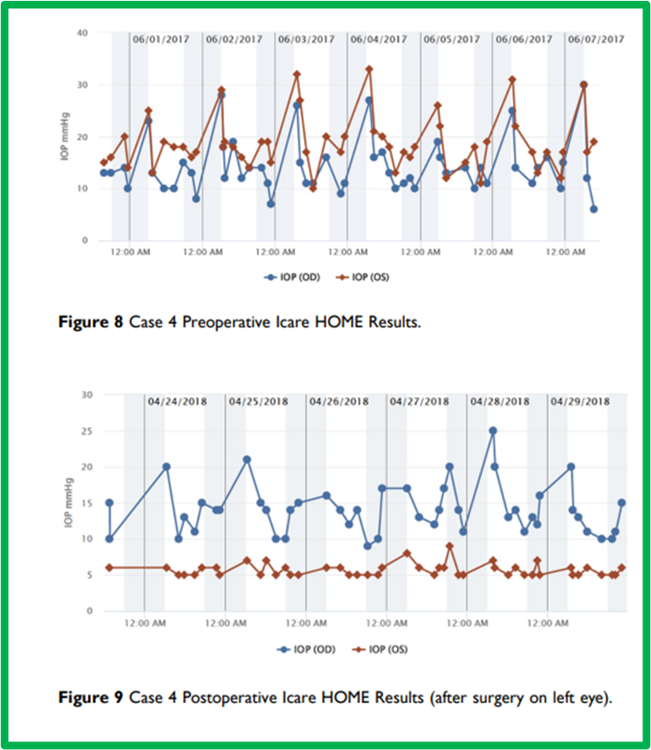
Clinical Benefits vs. Risks
Benefits
Medication adherence
Precision IOP treatment
Surgical pre/post-op monitoring
Diagnose “silent” disease
Emergent Angle Closure Glaucoma
Risks
Normal Tension Glaucoma (NTG)
Ocular Hypertension
Higher IOPs over estimated
Source: John Liu, Ticiana De Francesco, Matthew Schlenker, and Iqbal Ike Ahmed, 2020. "Icare Home Tonometer: A Review of Characteristics and Clinical Utility." Clin Ophthalmol 2020, no. 14 (Nov 23): 4031-4045, https://doi.org/10.2147/OPTH.S284844
Notes:
Benefits of IOP monitoring
- Med adherence and targeting specific IOPs with medication. Providers can make immediate medication dose adjustments and discuss with patients.
- Pre and postoperative IOP monitoring as demonstrated by the graph on the slide. We can see the preop IOPs for both eyes. After surgery we can see the red line which is the left surgical eye has maintained a lower IOP.
- obvious diagnosis of disease missed with a normal IOP seen in the clinic setting.
- lastly, patients with angle closure glaucoma and an elevated IOP is an ophthalmic emergency for which this device can diagnose and refer patient to emergency care.
Risks
- Normal tension glaucoma patients who will present with an average IOP of less than 21 mmHg will never spike an IOP. This is present in 50-70% of patients who are eventually diagnosed with primary open angle glaucoma. NTG is most prevalent in American Indians, Alaskan Natives, and Japanese Americans.
Ironically, NTG is common in patients who have “wide diurnal IOP fluctuations and nocturnal IOP spikes” which are the main reasons for using home tonometry. Also, Patients with vascular disease, diabetes and other systemic causes of NTG.
- Ocular hypertension or high IOPs can be caused by other systemic diseases and are not necessarily glaucoma.
- Lastly, Patients with naturally higher IOPs it has been shown this device can overestimate the IOP significantly.

Slide 6
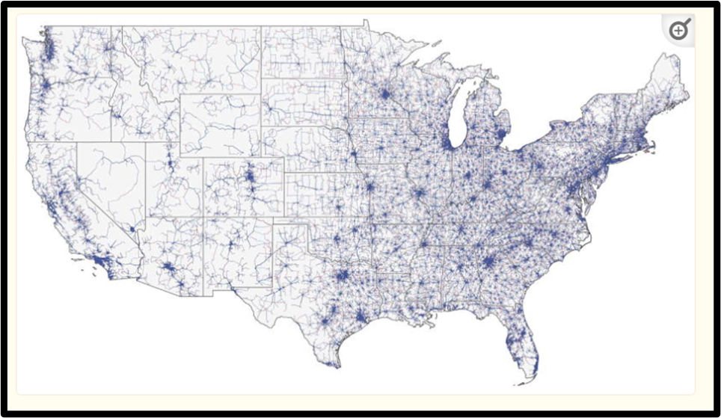
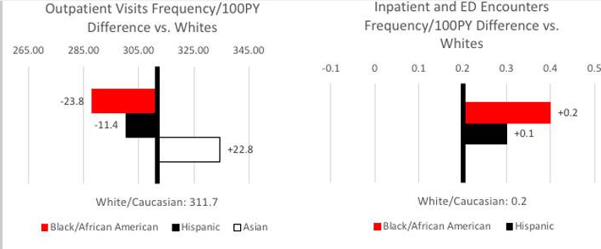
Operational Benefits vs. Risks
benefits
Teleglaucoma
Geographic reach
SDOH
Reduce # clinic visits
Reduce # ED visits
Streamline utilization and efficiency
Source: Cecilia S. Lee, MD, Aneesha Morris, Russell N. Van Gelder, MD, PhD, and Aaron Y. Lee, MD, MSC, 2016."Evaluating Access to Eye Care in the Contiguous United States by Calculated Driving Time in the United States Medicare Population.“ Ophthalmology 123, no.12 (December 2016): 2456-2461, https://doi.org/10.1016/j.ophtha.2016.08.015
risks
Telehealth use and training
Doesn’t eliminate need for additional eye tests
Fundus imaging
Ocular Coherence Tomography
Visual Fields
Source: Omar A Halawa, Ajay Kolli, Gahee Oh, William G Mitchell, Robert J Glynn, Dae Hyun Kim, David S Friedman, and Nazlee Zebardast, 2021. "Racial and socioeconomic differences in eye care utilization among Medicare beneficiaries with glaucoma.“ Ophthalmology 129, no.4 (April 2022): 397-405, https://doi.org/10.1016/j.ophtha.2021.09.022
Notes:
Benefits
- teleglaucoma and the geographic reach. The map on this slide shows the population of eyecare specialists in the US. As you can see most eye specialists are located in urban or metropolitan areas such as Denver. In areas such as the east coast this is not a big deal as the drive time/distances are not far, but in the mountain west the drive times are further. The CU Anschutz eye center treats patients in a 500 mile radius. With the the iCare HOME2 tonometer device
We can thus maintain treatment and monitoring of these patients with - SDOH can also benefit here. Patients that are nearby in the Denver metropolitan area or further away in rural areas and don’t have transportation to our clinic can use this device. Other SDOH factors that lead to non compliance can be better managed with telehealth using this device.
- The figures we see below the map are outpatient and ED visits for glaucoma from a recent study. The left graph shows outpatient visits of white vs. African American and Hispanics. The graph to the right is ED visits. We can see that African American and Hispanics are less likely to have outpatient visits and more likely to utilize the ED for glaucoma.
- This digital health tonometer can reduce the number of clinic visits for all patients. It can also reduce unnecessary ED visits.
- This digital health device will also streamline care for patients with more emergent glaucoma conditions.
Risks? It has been shown in recent studies that patients can be mailed the device and taught via telehealth. However, some have noted there is a “steep learning curve” for some and this could be an operational risk.
- The tonometer does not eliminate the need for additional eye testing which requires increased inpatient and outpatient services utilization.

Slide 7
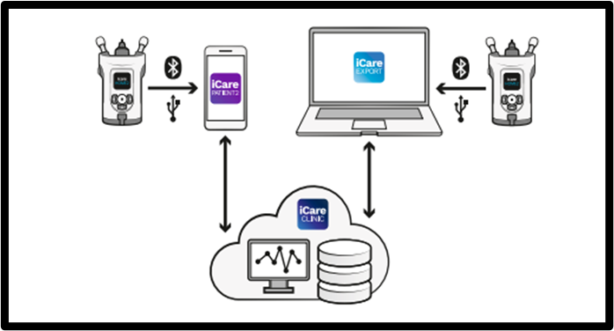
Technical Benefits vs. Risks
benefits
Data storage, Data Analytics, Data Transmission
Interoperability
“Big Data” (6 V’s) with 3 digital health apps (Ristevski et al. 2018)
Value
Volume
Velocity
Variety
Veracity
Variability
Source: iCare, 2023. “Icare CLINIC, Icare EXPORT, and Icare PATIENT app INSTRUCTION MANUAL FOR PATIENTS.” Accessed on September 30, 2023. https://www.icare-world.com/wp-content/uploads/2021/07/TS02-014-US-1.5-Icare-CLINIC-PATIENT-and-EXPORT-Instruction-Manual-for-Patient.pdf
risks
HIPAA
Data privacy
Data security
Notes:
The iCare HOME2 comes with 3 digital applications that we can see in this diagram.
- The iCare PATIENT2 mobile app, the iCare CLINIC cloud database, and the iCare Export in the far right.
- These 3 apps allow for data transmission, storage, and the “6 v’s” of big data. The more data we can collect on these patients the better care we can deliver.
Risks?
- probably the most common risks seen with healthcare data management including HIPAA, privacy and security.

Slide 8
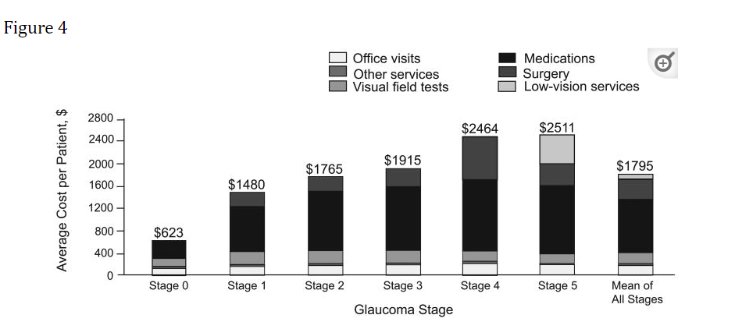
Financial Benefits
Cost per visit decrease
Medication Costs decrease
Source: Rohit Varma, Paul P. Lee, Ivan Goldberg, and Sameer Kotak, 2011. "An Assessment of the Health and Economic Burdens of Glaucoma." Am J Ophthalmol 152, no. 4 (October): 515-522, https://doi.org/10.1016/j.ajo.2011.06.004
OAG Severity | Median Pharmacy Costs | IQR
Severe | $493 | $122 - $1457
Moderate | $244 | $84 - $1113
Mild | $139 | $66 - $818
Source: Shih et al, 2021. "Clinical and Economic Burden of Glaucoma by Disease Severity: A United States Claims-Based Analysis." Ophthalmology Glaucoma 4, no. 5 (October): 490-503, https://doi.org/10.1016/j.ogla.2020.12.007
Notes:
On to financial benefits.
We can see There is a 4-fold increase in direct ophthalmology-related costs as glaucoma severity increases from asymptomatic to later stages of disease as seen in the first graph to the right. This device can help decrease the cost per visit through each stage.
Additionally, we know that Glaucoma medications are expensive regardless of the stage of the disease as we can see in the chart below, and this device can help us to deliver more precise medication dosages per target IOP and prevent prescribing multiple medications over the disease progression.

Slide 9
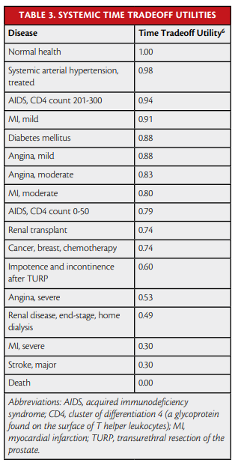
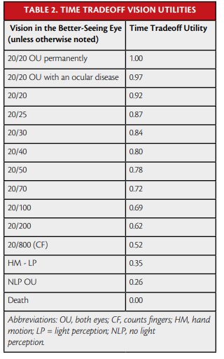
Financial Benefits – Value Based Medicine
Value Based Medicine in Ophthalmology
Ophthalmology was first specialty to support based on study by Brown et al in 2004.
“Value” of care based on ability to improve vision which improves quality of life or QALYs.
Value = Visual acuity in better seeing eye.
Glaucoma Diagnosis
Drops cost utility from 1.00 => 0.97
End Stage Bilateral Glaucoma
0.52 cost utility
Quality of life is 50% that of person with normal vision health.
Source: Gary C. Brown, MD, MBA; Melissa M. Brown, MD, MN, MBA; Joshua D. Stein, MD, MSc, MS; Richard P. Wilson, MD; and George L. Spaeth, MD, 2014. "Measuring the Impact of Glaucoma and the Value of Treatment: A primer on value-based medicine.“ Glaucoma Today. March/April 2014.
Source: Gary C. Brown, MD, MBA; Melissa M. Brown, MD, MN, MBA; Joshua D. Stein, MD, MSc, MS; Richard P. Wilson, MD; and George L. Spaeth, MD, 2014. "Measuring the Impact of Glaucoma and the Value of Treatment: A primer on value-based medicine.“ Glaucoma Today. March/April 2014.
Notes:
Financial Benefits are measured in what is known as “Value Based Medicine” or today commonly known as “Value Based Care.” The utility values for QALYs in eyecare are based on quality of visual acuity or vision strength in the better seeing eye. Usually with QALYs a score of 1 means you will live and zero means you will die but in ophthalmology it is based on the ability of a treatment to improve vision. The red chart above is from a landmark study in Ophthalmology in 2004 by Brown et al and republished in 2014. The authors introduced the concept of Value Based Medicine or Care in Ophthalmology. Table 2 is most important, Table 3 is included if systemic disease applies.
We can see how Value Based Medicine in Ophthalmology is represented by cost utility in the Table 2.
- A diagnosis of glaucoma, in the presence of 20/20 bilateral visual acuity drops the utility 3%, from 1.00 to 0.97. We can see this in the green font and the green box in the table.
- End-stage bilateral glaucoma is associated with a visual acuity of 20/800, the utility is assumed to be 0.52. We can see this in the red font and red box in the table.
- Thus, the overall quality of life is approximately 50% that of a person with normal ocular health and no vision problems. (Brown et al. 2014)

Slide 10
Financial Benefits – Value Based Medicine
QALYs and ICERs
Cost Utility = vision in better seeing eye!
First row
8 years of treatment end stage glaucoma
3.6 QALYs gained
Second Row
20 years of treatment, average 19.4 QALYs gained
Overall quality of life gain = 23%
23% of treated people will not go blind over 20 years
Aspect | Calculation | Value
QALY Gain | (0.97 - 0.52) × 8 = 0.45 × 8 | 3.6 QALYs
Patient Value Gain | (19.4 - 15.8)/15.8 = 23% | 23%
Source: Gary C. Brown, MD, MBA; Melissa M. Brown, MD, MN, MBA; Joshua D. Stein, MD, MSc, MS; Richard P. Wilson, MD; and George L. Spaeth, MD, 2014. "Measuring the Impact of Glaucoma and the Value of Treatment: A primer on value-based medicine.“ Glaucoma Today. March/April 2014.
Notes:
An example using this table for a glaucoma patient.
Let’s say a glaucoma treatment prevents end-stage bilateral glaucoma which is a cost utility = 0.52 and gives a patient the ability to maintain normal vision which is a cost utility = 0.97 for 8 years, the QALY gain is: (0.97 - 0.52) × 8 = 0.45 × 8 = 3.6 QALYs.
Second row the “big” takeaway for patient value gain is highlighted in red bold font.
- Over 20 years, the average person treated for glaucoma accrues 19.4 QALYs and the untreated person accrues 15.8 QALYs, the patient value gain from glaucoma therapy is: (19.4 - 15.8)/15.8 = 23%.
For glaucoma therapy, the value gain is equivalent to the quality-of-life gain. So 23% will not go blind if treated. This means treatment can and does improve the quality of life and can prevent blindness thus this is evidence even patients with end stage glaucoma are worth treating.
Source: Brown et al. 2014

Slide 11
Financial Benefits – Return on Investment
QALY Value | Avg Treatment Cost (21 years) | Average ROI 21 years | ROI Rate % (Annual) | ROI Rate % (21 years)
0.97 (early glaucoma) | $7,555 | $467,160 | 42.88% | 5994%
0.5 (end-stage glaucoma) | $7,555 | $467,160 | 23.49% | 3042%
Fig. 1. ROI QALY comparison early glaucoma vs. end-stage glaucoma (Brown et al. 2014)
Avg Treat Cost per QALY | Average ROI (QALY) Calculation | Annual ROI Rate per QALY | Treatment Cost per QALY (Annual) | Treatment Cost per QALY (21 years)
$7,555 * 0.97 = $7,324.35 | $467,160 * 0.97 | 42.88% * 0.97 = 41.58% | $7,324.35 / 0.97 = $7,553.25 | $7,555 / 0.97 = $7,781.44
$7,555 * 0.5 = $3,777.50 | $467,160 * 0.5 | 23.49% * 0.5 = 11.75% | $3,777.50 / 0.5 = $7,555.00 | $7,555 / 0.5 = $15,110.00
Fig. 2. ROI QALY Treatment Cost Comparison: Annual vs. 21 years
Notes:
- Regarding financial gain with improved visual acuity, depression, injuries, hospital admissions, and caregiver costs decrease while wages increase.
- The average 21-year treatment cost known from a landmark study in Ophthalmology by Brown et al. is $7,555, while the average return for preventing end-stage glaucoma is $474,715, for a return on investment of 23% annually and 6,284% over 21 years.
The charts above use this information from the Brown et al study.
Figure 1
- This is a ROI QALY comparison of early glaucoma vs. end-stage glaucoma.
- The QALY cost utility numbers come from the QALY chart seen 2 slides earlier from Brown et al study.
- We can see that while treating early stage glaucoma has a higher ROI, the ROI for treating end stage glaucoma is still significant.
Figure 2
- ROI QALY Treatment Cost Comparison annual vs. 21 years.
- The treatment cost values used in dollars were taken from the Brown et al study.
- First column we see is the average treatment cost per QALY based on the average cost of treatment over 21 years.
- 2nd column we see the Average ROI per QALY calculation using the Average ROI over 21 years.
- 3rd column we see the Annual ROI Rate per QALY based on the information from Figure 1.
- 4th column we see the Treatment cost per QALY annual for mild glaucoma top row vs. end-stage glaucoma bottom row. We can see the cost is basically the same.
- The 5th and final column does show us the significant differences in treatment cost per QALY over 21 years average of treatment. 21 years of treating mild glaucoma does not change much for cost, but 21 years of treating end stage glaucoma does virtually double the treatment costs.
Keep in mind these are estimates based off a landmark study. They will vary per patient, per treatment.
What we can takeaway from this is that using IOP remote monitoring we can potentially reduce the annual and 21 year costs and the ROI overall
Is worth it per QALY per patient and for the overall healthcare system.

Slide 12
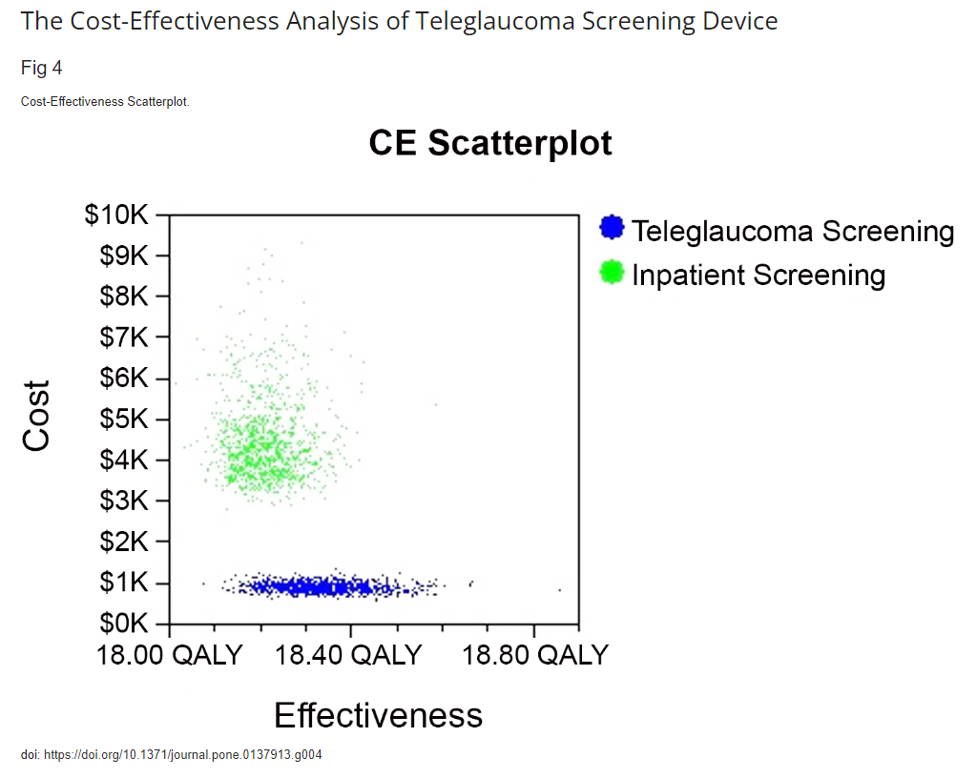
Financial Benefits – Value Based Medicine
QALYs Applied to Glaucoma Treatments
Teleglaucoma Study
No treatment vs. Surgery vs. Medication
Summary of all financial benefit slides
- IOP monitoring is cost effective
- ROI is worth treatment costs
- QALYs are worth treatment costs
Source: Thomas S, Hodge W, Malvankar-Mehta M, 2015. "The Cost-Effectiveness Analysis of Teleglaucoma Screening Device." PLoS ONE 10(9): e0137913. https://doi.org/10.1371/journal.pone.0137913
Intervention | Costs ($) | QALYs (Total) | ICER ($/QALY gained)
No Treatment | $2700 | 16.06 | -
Laser Trabeculoplasty (LTP) | $13,788 | 16.71 | $16,824/QALY
Prostaglandin Analogue (PGA) | $18,101 | 17.14 | $14,179
Source: John Liu, Ticiana De Francesco, Matthew Schlenker, and Iqbal Ike Ahmed, 2020. "Icare Home Tonometer: A Review of Characteristics and Clinical Utility." Clin Ophthalmol 2020, no. 14 (Nov 23): 4031-4045, https://doi.org/10.2147/OPTH.S284844
Notes:
QALYs applied to glaucoma Treatments
1. Scatterplot to right: Teleglaucoma QALYs from a recent study. Although this is a Canadian study, we can see that the QALYs are higher with lower cost for treatment for teleglaucoma than for inpatient or clinic screenings.
- we can see that teleglaucoma using remote monitoring is more cost effective.
- 0.12 QALY gained per patient exam.
- ICER of $27,460/QALY
- Teleglaucoma will save $27,460 for each QALY gained.
- Blindness prevented in 24% of patients after 30 years. => this is the patient value gain.
In the chart at the bottom, we can see:
2. A study by Stein et al. on open angle glaucoma (OAG) for 3 interventions: no treatment, LTP and PGA meds.
- Total QALYs for 3 treatments
- ICER (incremental cost effectiveness ratio) for all 3 treatments.
- initially medication adherence was considered the best option based on QALY, but when considered “realistic medication adherence” LTP surgery was more cost effective.
The main takeaway from this slide and the previous slides is that home IOP monitoring can lead to more cost effective outcomes in treatment for glaucoma.
- Teleglaucoma shows that by consistently monitoring a patients condition it can lead to vision improvements or QALY gains.
- The bottom table from Stein’s study shows that if you don’t treat glaucoma, meaning if you just see a patient every few months or even once a year without consistent monitoring of their IOP, the cost will be low, but the QALY will be low. Using IOP monitoring it can drive the need for more advanced treatments like LTP or PGA which lead to more cost effective ICERs and QALY meaning the patient can potentially gain their sight back and improved quality of life.

Slide 13
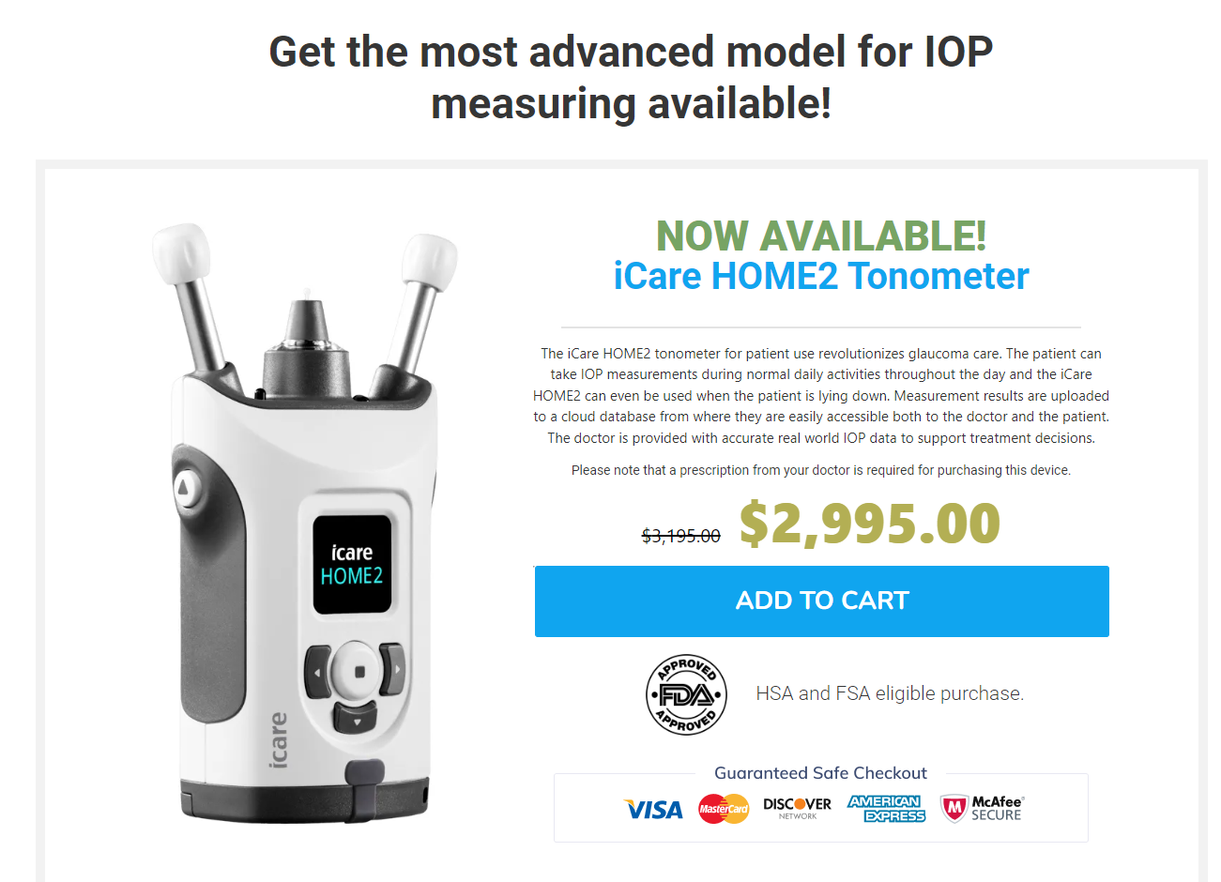
Financial Risks
Device cost ~$3,000
Not covered by insurance
Does not eliminate need for further eye testing
Source: myeyes.net, 2023. "Product." Accessed on September 23, 2023. https://myeyes.net/product/icare-home2-tonometer-purchase/
Notes:
- The cost of the device is upwards of $3,000 and Insurance does not cover it. The device can be rented out to patients but is an expensive endeavor for a healthcare organization, the patient and all parties involved.
- The device while eliminating some financial waste in the healthcare system such as unnecessary ED or outpatient visits, it does not take away the need for further eye testing.

Slide 14
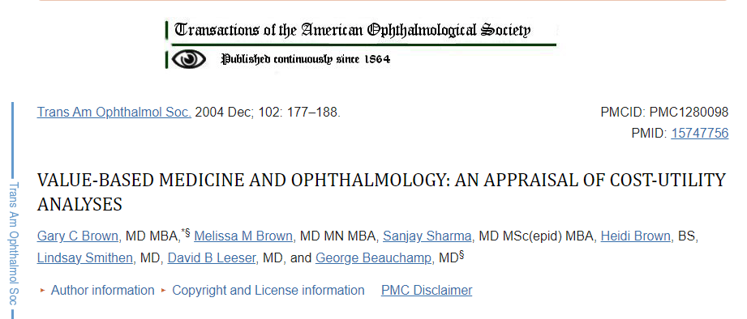
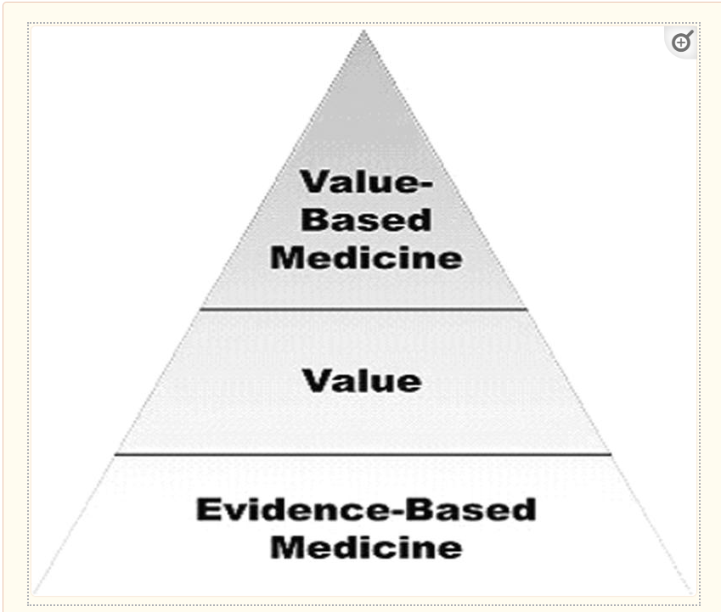
Recommendation
Why utilize this device?
CDC’s Vision Health Initiative (VHI) for blindness
Social Determinants of Health
Value Based Medicine
Quality of life improvements
Cost effectiveness
Reduce clinic visits
Reduce medication costs
Precision treatments
ROI and Treatment costs are worth the QALYs gained.
Source: Gary C Brown, MD MBA, Melissa M Brown, MD MN MBA, Sanjay Sharma, MD MSc(epid) MBA, Heidi Brown, BS, Lindsay Smithen, MD, David B Leeser, MD, and George Beauchamp, MD, 2004.
"Value-Based Medicine and Ophthalmology: An Appraisal Of Cost-Utility Analyses."
Trans Am Ophthalmol Soc 2004, no. 102 (December): 177-185, PMID: 15747756;
Source: Gary C Brown, MD MBA, Melissa M Brown, MD MN MBA, Sanjay Sharma, MD MSc(epid) MBA, Heidi Brown, BS, Lindsay Smithen, MD, David B Leeser, MD, and George Beauchamp, MD, 2004.
"Value-Based Medicine and Ophthalmology: An Appraisal Of Cost-Utility Analyses."
Trans Am Ophthalmol Soc 2004, no. 102 (December): 177-185, PMID: 15747756;
Notes:
I absolutely recommend we invest in this device. This is based on a few factors.
This aligns with the CDC’s “VHI” to reduce blindness as it is a major public health concern in the US and worldwide.
SDOH are a major factor in this disease. Being able to reach patients via teleglaucoma will prevent the need for them obtaining transportation, and will also help with other SDOH factors.
Value Based Medicine. This is now commonly known as “Value Based Care“. As I mentioned earlier, this applied to eyecare shows us that most ophthalmology treatments for chronic eye diseases help improve vision and thus help improve quality of life or quality adjusted life years. This means eye treatments are cost effective for improving a patient’s quality of life.
The pyramid below is from this original study and still published in many glaucoma and ophthalmology study.
We can improve glaucoma patient’s vision and quality of life and do so in a cost effective manner using this device.

Slide 15
References
Blagoj Ristevski and Ming Chen, 2018. "Big Data Analytics in Medicine and Healthcare." J Integr Bioinform 15, no. 3 (September): 1-5, https://doi.org/10.1515/jib-2017-0030
CDC, 2023. "Social Determinants of Health, Health Equity, and Vision Loss." Accessed on October 28, 2023. https://www.cdc.gov/visionhealth/determinants/index.html
Cecilia S. Lee, MD, Aneesha Morris, Russell N. Van Gelder, MD, PhD, and Aaron Y. Lee, MD, MSC, 2016."Evaluating Access to Eye Care in the Contiguous United States by Calculated Driving Time in the United States Medicare Population.“ Ophthalmology 123, no.12 (December 2016): 2456-2461, https://doi.org/10.1016/j.ophtha.2016.08.015
CU Anschutz, 2023. "Department of Ophthalmology." Accessed on October 28, 2023. https://medschool.cuanschutz.edu/ophthalmology/about-us
FDANEWS, 2022. "Icare USA’s iCare Home2 Self-Tonometer Wins FDA’s 510(k) Clearance." Accessed on November 1, 2023. https://www.fdanews.com/articles/207237-icare-usas-icare-home2-self-tonometer-wins-fdas-510k-clearance
Gary C Brown, MD MBA, Melissa M Brown, MD MN MBA, Sanjay Sharma, MD MSc(epid) MBA, Heidi Brown, BS, Lindsay Smithen, MD, David B Leeser, MD, and George Beauchamp, MD, 2004. "Value-Based Medicine and Ophthalmology: An Appraisal Of Cost-Utility Analyses."Trans Am Ophthalmol Soc 2004, no. 102 (December): 177-185, PMID: 15747756; PMCID: PMC1280098.
Gary C. Brown, MD, MBA; Melissa M. Brown, MD, MN, MBA; Joshua D. Stein, MD, MSc, MS; Richard P. Wilson, MD; and George L. Spaeth, MD, 2014. "Measuring the Impact of Glaucoma and the Value of Treatment: A primer on value-based medicine.“ Glaucoma Today. March/April 2014.
Gary C. Brown and Melissa M. Brown, 2019. "Patient Preference-Based Comparative Effectiveness and Cost-Utility Analysis of the Prostamides for Open-Angle Glaucoma.“
Journal of Ocular Pharmacology and Therapeutics 35, no. 3 (April), https://doi.org/10.1089/jop.2018.0114
iCare, 2023. "iCare HOME2." Accessed on September 19, 2023. https://www.icare-world.com/us/product/icare-home2/
iCare, 2023. “Icare CLINIC, Icare EXPORT, and Icare PATIENT app INSTRUCTION MANUAL FOR PATIENTS.” Accessed on September 30, 2023. https://www.icare-world.com/wp-content/uploads/2021/07/TS02-014-US-1.5-Icare-CLINIC-PATIENT-and-EXPORT-Instruction-Manual-for-Patient.pdf

Slide 16
References (continued)
John Liu, Ticiana De Francesco, Matthew Schlenker, and Iqbal Ike Ahmed, 2020. "Icare Home Tonometer: A Review of Characteristics and Clinical Utility." Clin Ophthalmol 2020, no. 14 (Nov 23): 4031-4045, https://doi.org/10.2147/OPTH.S284844
Joshua D. Stein, MD, MS; David D. Kim, BS; Will W. Peck, BS; et al, 2012. "Cost-effectiveness of Medications Compared With Laser Trabeculoplasty in Patients With Newly Diagnosed Open-Angle Glaucoma.“ Arch Ophthalmol 130, no. 4 (February):497-505, https://doi.org/10.1001/archophthalmol.2011.2727
myeyes.net, 2023. "Product." Accessed on September 23, 2023. https://myeyes.net/product/icare-home2-tonometer-purchase/
Nancy M. Holekamp, MD; Steven B. Duff, MS; and Yamina Rajput, MS, 2016. "Quality-Adjusted Life Years for the Retina Specialist." Retina Today (March 2016): 51-54.
Omar A Halawa, Ajay Kolli, Gahee Oh, William G Mitchell, Robert J Glynn, Dae Hyun Kim, David S Friedman, and Nazlee Zebardast, 2021. "Racial and socioeconomic differences in eye care utilization among Medicare beneficiaries with glaucoma.“ Ophthalmology 129, no.4 (April 2022): 397-405, https://doi.org/10.1016/j.ophtha.2021.09.022
Rohit Varma, Paul P. Lee, Ivan Goldberg, and Sameer Kotak, 2011. "An Assessment of the Health and Economic Burdens of Glaucoma." Am J Ophthalmol 152, no. 4 (October): 515-522, https://doi.org/10.1016/j.ajo.2011.06.004
Shih et al, 2021. "Clinical and Economic Burden of Glaucoma by Disease Severity: A United States Claims-Based Analysis." Ophthalmology Glaucoma 4, no. 5 (October): 490-503, https://doi.org/10.1016/j.ogla.2020.12.007
Tarun Arora, Shveta Jindal Balib, Vishal Aroraa, Meenakshi Wadhwania, Anita Pandaa, Tanuj Dadaa, 2015. "Diurnal versus office-hour intraocular pressure fluctuation in primary adult onset glaucoma.“ Journal of Optometry 8, no. 4 (October-December 2015): 239-243, https://doi.org/10.1016/j.optom.2014.05.005
Thomas S, Hodge W, Malvankar-Mehta M, 2015. "The Cost-Effectiveness Analysis of Teleglaucoma Screening Device." PLoS ONE 10(9): e0137913. https://doi.org/10.1371/journal.pone.0137913
Wittel, Rachel, 2022. "Telemedicine Strengthens Glaucoma Diagnosis and Management." Accessed on October 28, 2023. https://news.cuanschutz.edu/ophthalmology/telemedicine-strengthens-glaucoma-diagnosis-and-management

